Slide 1

Cardiovascular Disease Prediction
Group: 32
Presentation By:
Arnav Gupta
Karan Gupta
Shivesh Gulati
Vishal Singh
2021236
2021258
2021286
2021575

Slide 2



Outline
Introduction and Motivation
Literature Review
Dataset Description
Models and Methodologies
Result Analysis and Conclusion
Timeline
Contributions

Slide 3
Introduction and Motivation

Slide 4
Outline
Introduction and Motivation
Literature Review
Dataset Description
Models and Methodologies
Result Analysis and Conclusion
Timeline
Contributions

Slide 5
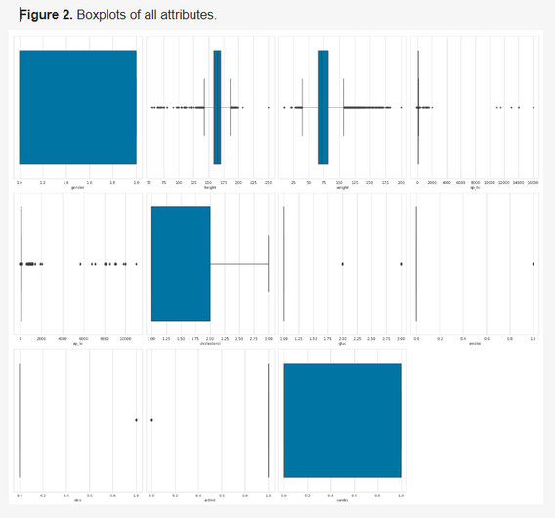

Literature Review
Research Paper-1
Aim: To develop a machine learning model to predict Cardiovascular
Disease Accurately
The dataset used, consisting of 70,000 records, was taken from Kaggle.com.
The study uses Decision trees, XGBoost, Random forest, and multilayer perceptron models. These were optimized using GridSearchCV.
Since dataset was mostly categorical, various techniques for outlier detection were used, resulting data had 57,155 instances.
Feature engineering such as binning(converting continuous data to categorical) was applied to age, height, weight, systolic blood pressure, and diastolic blood pressure.
Images taken from : https://www.mdpi.com/1999-4893/16/2/88

Slide 6
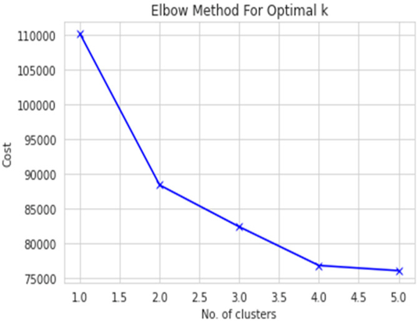
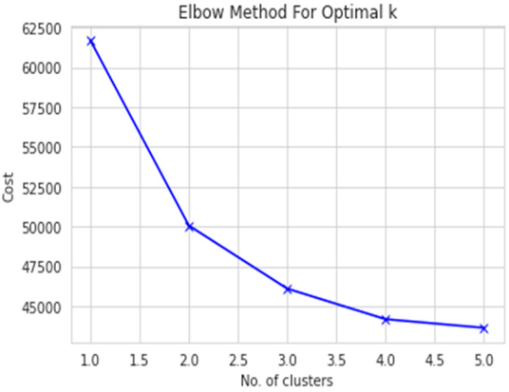
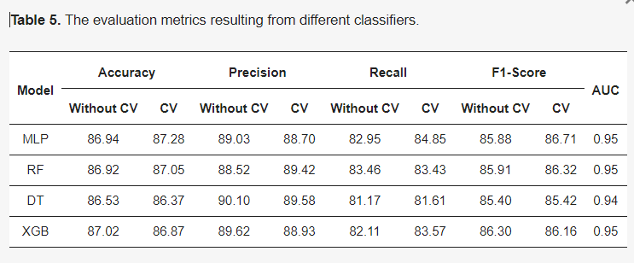
Literature Review
Research Paper-1(continued)
Aim: To develop a machine learning model to predict Cardiovascular
Disease Accurately
Two derived parameters, viz Body Mass Index (BMI) and Mean Arterial Pressure (MAP), were derived from age, weight, Systolic Blood Pressure, Diastolic Blood Pressure, respectively.
K-Modes clustering was used over K-means as it was not suitable for categorical dataset. optimal number was found using elbow curve method.
The dataset was divided on gender basis for better prediction.
The dataset was split into 80:20 for training and testing.
MLP was best to perform with an accuracy of 87.28% and other algorithms like XGBoost and random forest also showed comparable performances.
To conclude, this research paper applied models that achieved an accuracy of >86%, which could be further improved in the future to get more accurate predictions of CVD
Images taken from : https://www.mdpi.com/1999-4893/16/2/88

Slide 7
Literature Review
Research Paper-2
Aim: To understand the effectiveness of various BP indices in predicting Cardiovascular Diseases using Machine Learning Models.
The dataset used in this study, although not known in its entirety, was obtained from the ADVANCE study and consisted of the following attributes: age, sex, gender, SBP, MAP, DBP, PP, smoking, total cholesterol (HbA1c), and duration of mellitus (type-2 diabetes)
COX Proportional Hazard Regression Models were used to find the Hazard Ratio and the 95% confidence interval.
The ability of different BP indices, to discriminate among the participants was measured using AUC analysis.
For multivariate analysis, RIDI (Relative Integrated Discrimination Improvement) was used, which measured the increase in the discrimination obtained when new variables were introduced to the prediction model.

Slide 8
Literature Review
Research Paper-2
Conclusions: The overall conclusions obtained from the study were as follows:
It was observed during the study that for baseline BP estimates pulse Pressure (PP) and Mean Arterial Pressure (MAP) were more effective in CVD prediction.
In the case of achieved BP estimates, Systolic Blood Pressure (SBP) and Mean Arterial Pressure (MAP) performed better compared to other metrics.
Overall, if a combination of Blood Pressure variables is used, it was concluded that SBP and P are superior to MAP and DBP in predicting CVD-related events.
DBP was observed to be the worst for predicting CVD-related events, mainly because of the fact that DBP tends to remain constant or even decrease after the age of 50-60 years

Slide 9
Outline
Introduction and Motivation
Literature Review
Dataset Description
Models and Methodologies
Result Analysis and Conclusion
Timeline
Contributions

Slide 10












Shape Size and Derived Features
Dataset Source
Kaggle
Original Shape and Size
70,000 rows
13 columns
Target Variable
A binary variable “cardio“
(0 for no CVD, 1 for presence of CVD)
Summary of the dataset features
Dropped Column
Patient ID
Derived Features
Pulse Pressure (PP) = ap_hi-ap_lo
Mean Arterial Pressure (MAP) = ap_lo+1/3(PP)
Final Shape and SIze
70,000 rows and 14 columns (excluding Patient Id and adding PP and MAP)

Slide 11
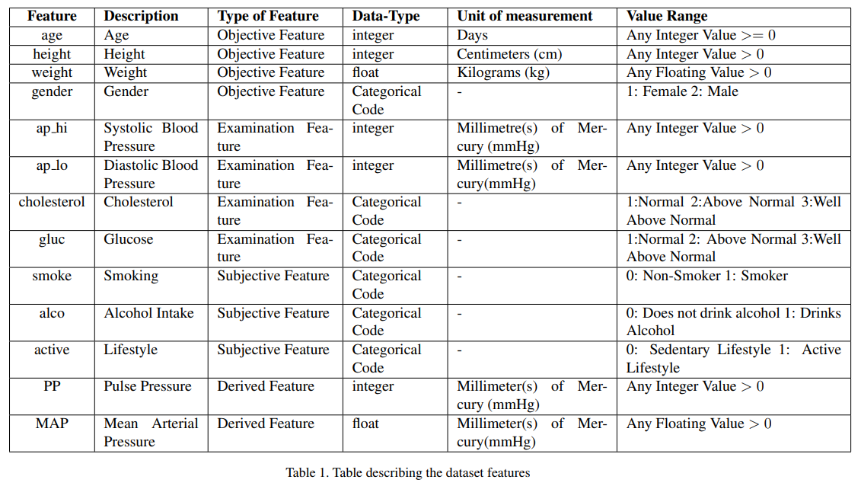
Feature Description

Slide 12
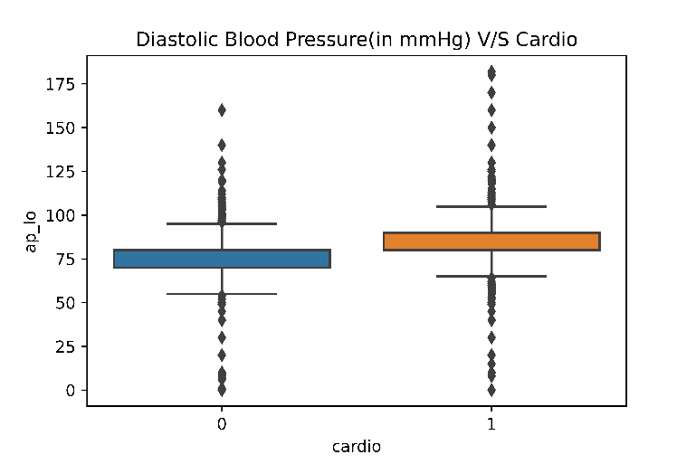
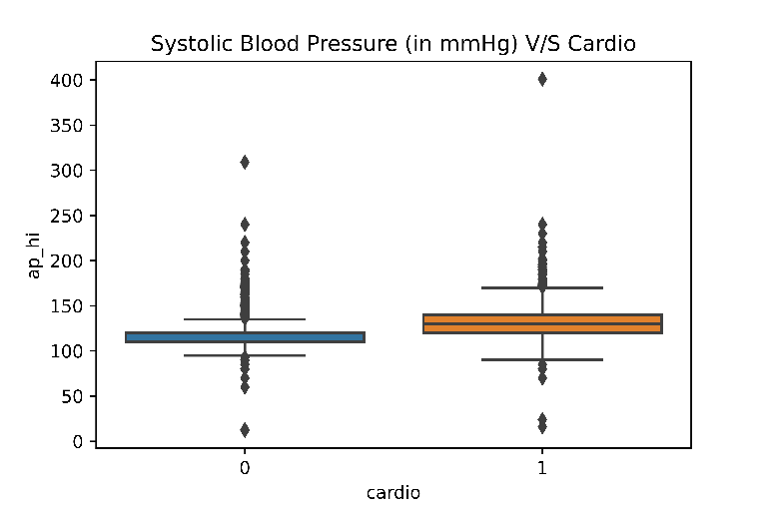
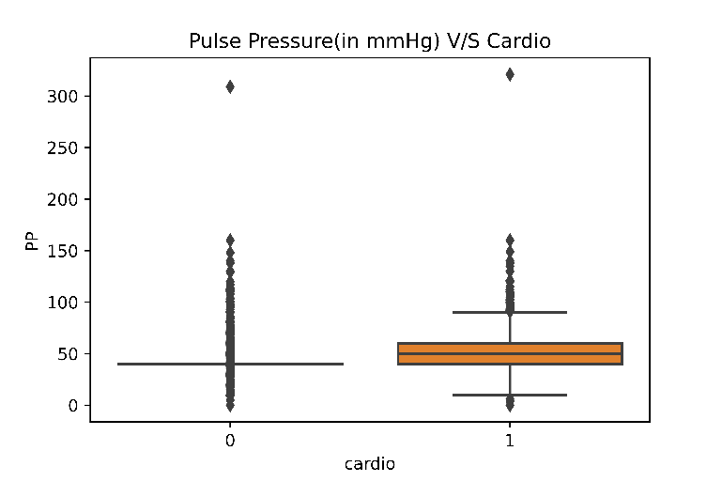
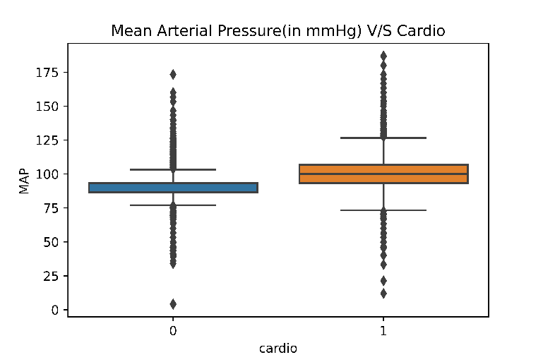
Box Plots
Inference
Inference
The number of outliers, in case of Diastolic Blood Pressure are high
The number of outliers, in case of Systolic Blood Pressure are higher than Dyastolic Blood pressure, but the quartiles are better defined.
Inference
Inference
The number of outliers, in case of pulse pressure are the highest.
Mean Arterial Pressure, shows the least number of outliers, and has significant size of the box.

Slide 13
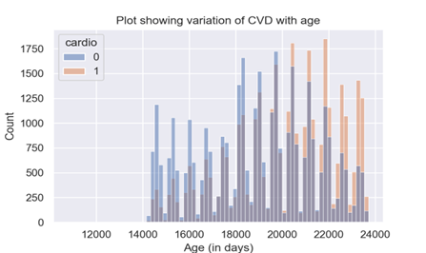
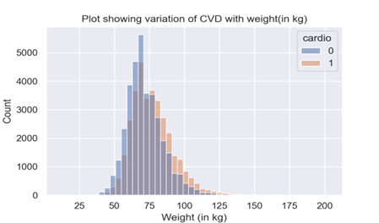
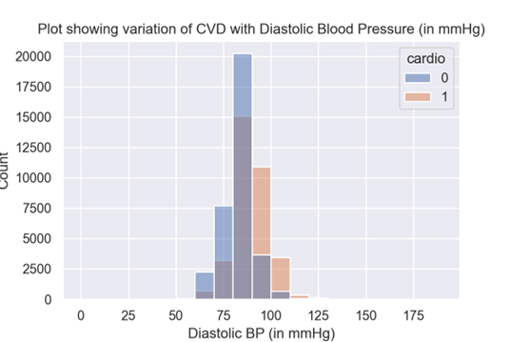
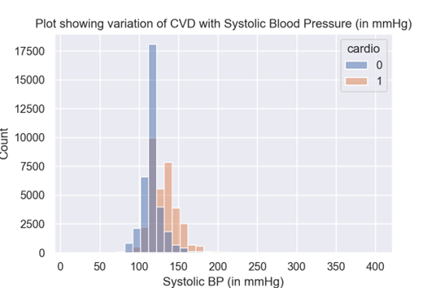
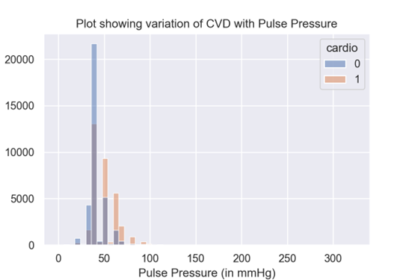
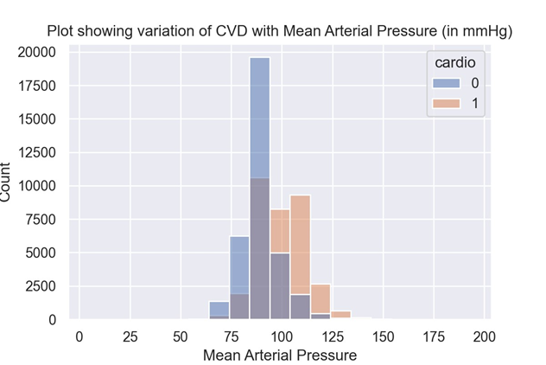
Histograms
Graph-1
Graph-2
Graph-3
Graph-4
Graph-5
Graph-6

Slide 14
Inferences from Histograms
Histograms were drawn to analyze the distribution of participants, with or without CVD, in specific ranges of the various numerical features. The insights obtained are as follows:-
As the age bracket increases, the number of people with CVD is higher than those without CVD, especially for people beyond 22500 days (61 years). (See Figure 1)
As the weight bracket increases, the proportion of people having CVD is significantly higher as compared to those not having CVD, especially in the 75 kg and beyond range (See Figure 2).
In populations with higher systolic, diastolic, and pulse pressures, cardiovascular disease (CVD) frequency is higher. Specifically, systolic BP >=140 mmHg, diastolic BP>=90 mmHg, and pulse pressure >=50 mmHg are associated with increased CVD prevalence. (See Figures 3,4,5,6).

Slide 15
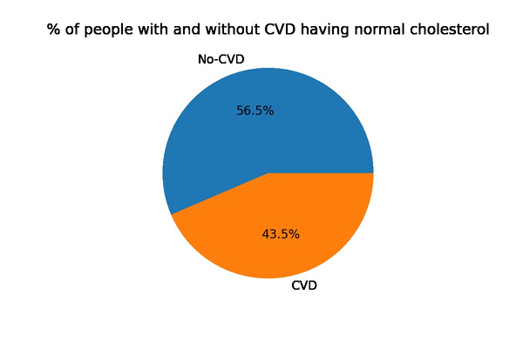
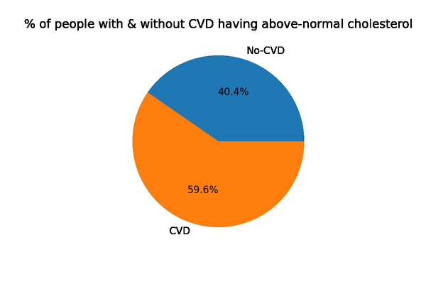
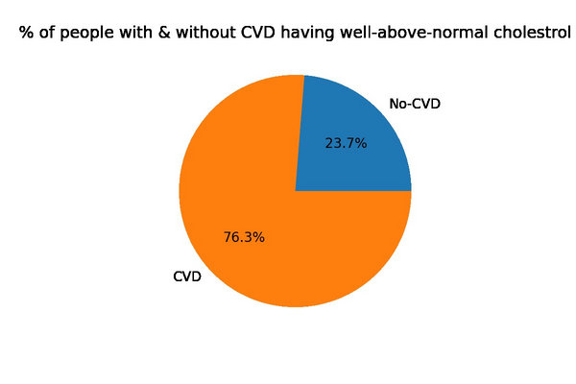
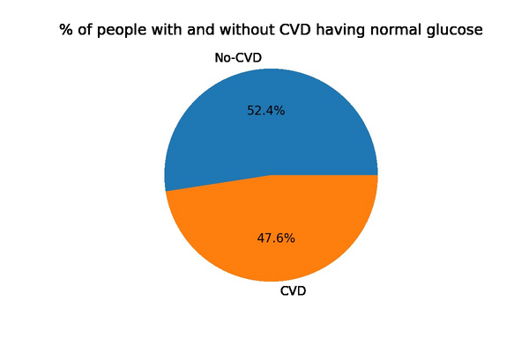
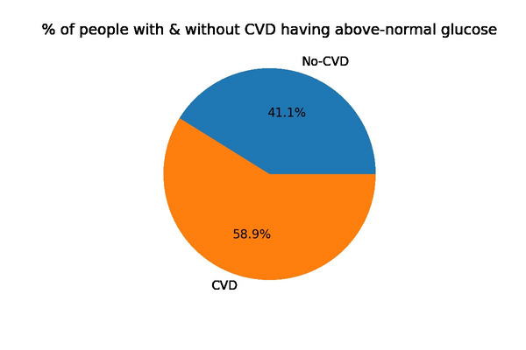
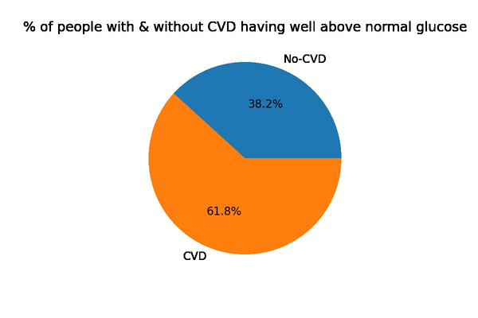
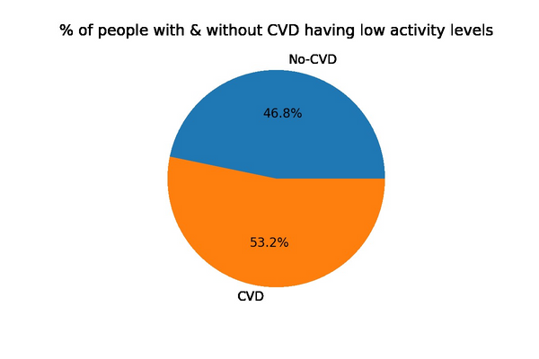
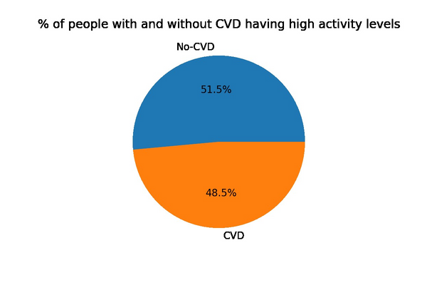
Pie Charts
Inferences
Pie charts were used to analyze the distribution of participants, with or without CVD, in various categories of categorical features :-
1) Proportion of people not having CVD in the normal cholesterol level category is higher as compared to the people having CVD in the above-normal and well-above normal cholesterol categories the proportion of people, having CVD, is higher, as compared to those not having CVD. A similar trend can be seen in glucose levels as well.
2) Out of the people with an active lifestyle, the proportion of people not having CVD is higher than those with CVD. Similarly, the people with a sedentary lifestyle have a higher proportion of people who have CVD than the ones not having CVD.

Slide 16
Outline
Introduction and Motivation
Literature Review
Dataset Description
Models and Methodologies
Result Analysis and Conclusion
Timeline
Contributions

Slide 17




Flow Chart
Z-Score
Data Preprocessing
Model
Application
Naive Bayes
Logistic Regression
SVM
Data
Data input
Outlier
Detection
Naive Bayes
Logistic Regression
LOF
Data Preprocessing
Model
Application
SVM

Slide 18
Feature Extraction
Manual CAP
For the original and derived features of Blood Pressure, Values not in the range [0,500] were manually dropped.
Outlier Detection and Cleaning
Z-Score
70,000
68,727
Applied Z-Score on the Manually Capped Data
68,727
65,048
LOF
Applied Local Outlier Factor on the Manually Capped Data
68,727
54,981

Slide 19
Flow Chart
Z-Score
Data Preprocessing
Model
Application
Naive Bayes
Logistic Regression
SVM
Data
Data input
Outlier
Detection
Naive Bayes
Logistic Regression
LOF
Data Preprocessing
Model
Application
SVM

Slide 20
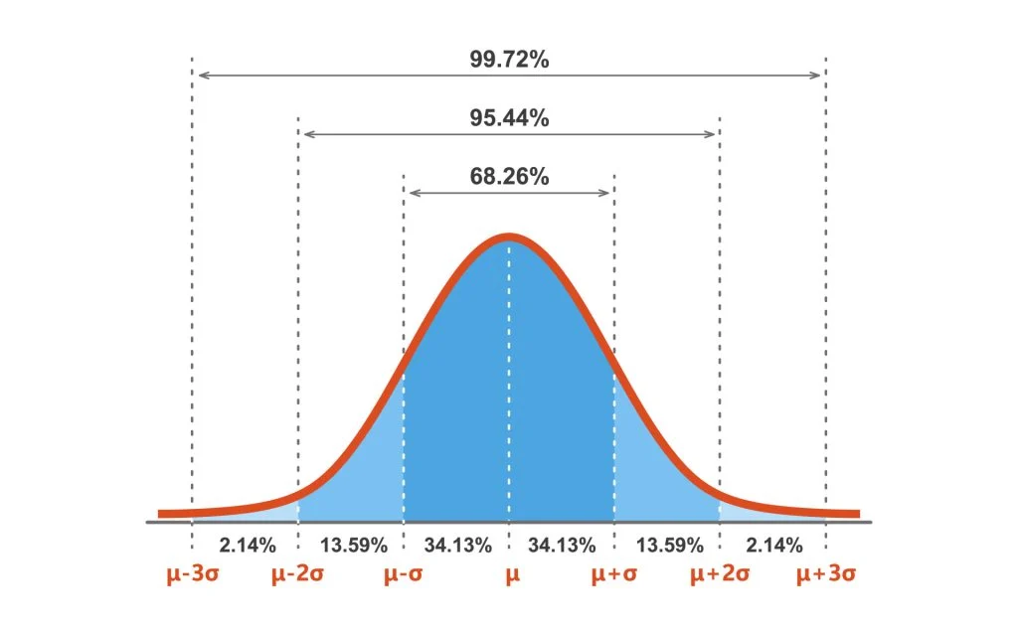
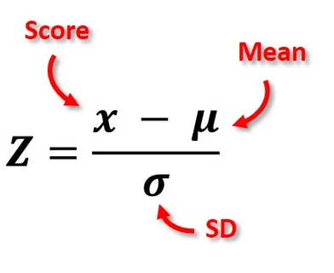
Z-Score
Formula
Lower bound=-2.75
Upper bound=2.75
Final size: 65,048

Slide 21
Flow Chart
Z-Score
Data Preprocessing
Model
Application
Naive Bayes
Logistic Regression
SVM
Data
Data input
Outlier
Detection
Naive Bayes
Logistic Regression
LOF
Data Preprocessing
Model
Application
SVM

Slide 22
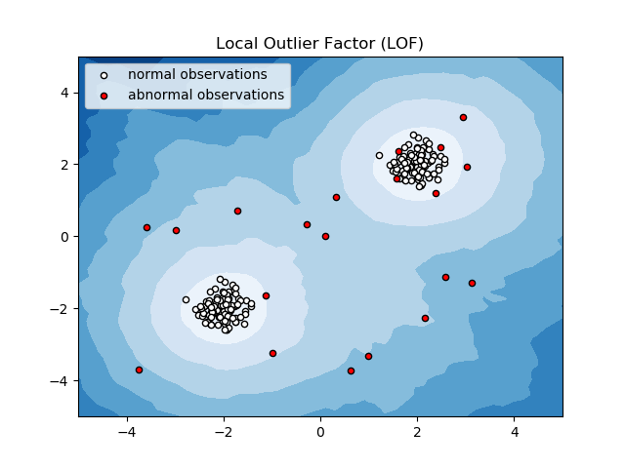
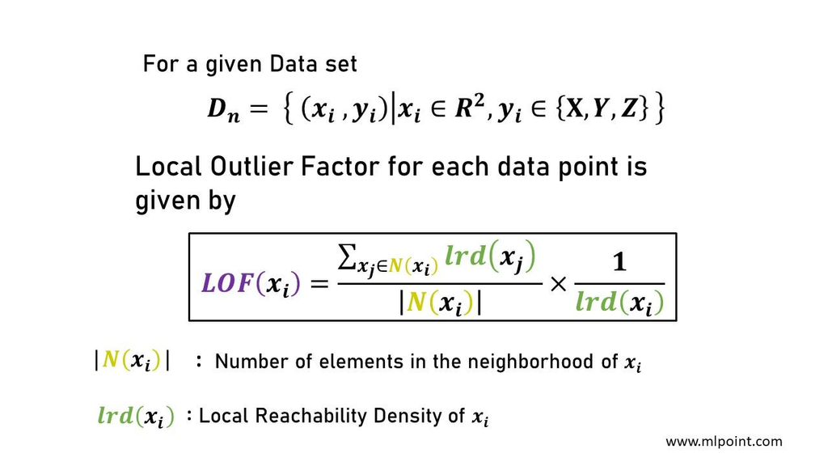
Local Outlier Factor
Formula
Final size: 54,981

Slide 23
Flow Chart
Z-Score
Data Preprocessing
Model
Application
Naive Bayes
Logistic Regression
SVM
Data
Data input
Outlier
Detection
Naive Bayes
Logistic Regression
LOF
Data Preprocessing
Model
Application
SVM

Slide 24
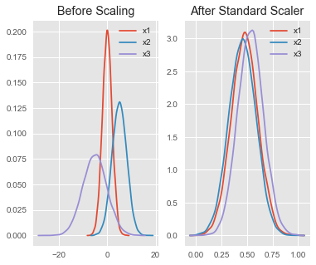
Feature Extraction
Data Standardization
StandardScaler()

Slide 25

Flow Chart
Z-Score
Data Preprocessing
Model
Application
Naive Bayes
Logistic Regression
SVM
Data
Data input
Outlier
Detection
Naive Bayes
Logistic Regression
LOF
Data Preprocessing
Model
Application
SVM

Slide 26

Models and Methodologies
Classification Problem
Naive Bayes Classifier
Logistic Regression Classifier
Support Vector Machine

Slide 27
Models and Methodologies
Standard Data
The Original Data had Label Based Encoded Features and Models were applied.
Data Processing
One Hot Encoding
The Original Label Based Features were converted to One Hot Encoding and the Models were applied.
One Hot Encoding + PCA
The One Hot Encoded data was used with PCA and the Models were applied.

Slide 28
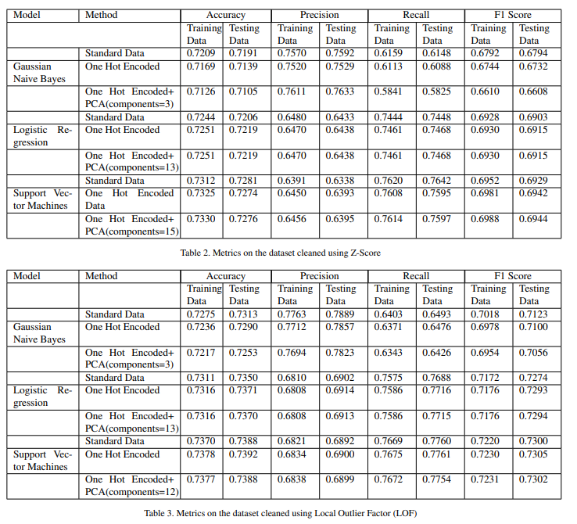
Models (Stats)
LOF
Z-Score
Naive Bayes
0.75
LOF Data
Standard Data
One Hot Encoded Data
One Hot + PCA Data
0.5
0.25
Z-Score Data
Standard Data
One Hot Encoded Data
One Hot + PCA Data
0
Stand.
One Hot
PCA
Accuracy

Slide 29
Models (Stats)
LOF
Z-Score
Logistic Regression
0.75
LOF Data
Standard Data
One Hot Encoded Data
One Hot + PCA Data
0.5
0.25
Z-Score Data
Standard Data
One Hot Encoded Data
One Hot + PCA Data
0
Stand.
One Hot
PCA
Accuracy

Slide 30
Models (Stats)
LOF
Z-Score
Support Vector Machine
0.75
LOF Data
Standard Data
One Hot Encoded Data
One Hot + PCA Data
0.5
0.25
Z-Score Data
Standard Data
One Hot Encoded Data
One Hot + PCA Data
0
Stand.
One Hot
PCA
Accuracy

Slide 31
Models (Stats)
Accuracy
Precision
Recall
F1-Score
3
2
1
0
Naive Bayes
Logistic
SVM

Slide 32
Analysis
If either accuracy or F1 score is used as a metric to evaluate the models, then a clear-cut trade-off can be observed in the models' precision and recall simply because the accuracy increase comes either at the expense of a lower recall or a lower precision.
In our case scenario, we are more concerned with false negatives than false positives. Therefore positives. Thus, unequal weight is given to misclassification. Thus, a model having higher recall is more desirable. Out of all the models trained, the best re?call was observed in the case of Support Vector Machines (0.7754) on the one hot encoded data, with PCA cleaned using the LOF outlier detection method, which was closely followed by logistic regression with a recall of 0.7715 on the same dataset and following the same methodology.
Since we are giving unequal weights to misclassification, the F1 Score would be an overall better metric to gauge the model’s performance as compared to accuracy. It can be observed that the F1 scores of all the models trained on the data with LOF as a method of outlier removal were higher than the models trained on data with Z-Score as the outlier removal method.
Among the values for the F1 score achieved on the models trained on the dataset with LOF as the outlier removal method, the best performance was achieved by Support Vector Machines (SVM) with an F1 score of 0.7305 on the testing data after one hot encoding was applied on the dataset. This was closely followed by Logistic Regression, which was able to achieve an F1 score of 0.7293 on the testing data

Slide 33
Conclusion
From the above analysis, it can be concluded that out of Naive Bayes, Logistic Regression, and Support Vector Machines, the best performance (considering F1 score as the overall evaluation metric) was achieved by Support Vector Machines (0.7305) followed by Logistic Regression (0.7294) and Naive Bayes (0.7274). This makes SVM the best model if only model performance is the concern.
training times are also considered, making logistic regression the best model since it offers an almost comparable F1 score as SVM but has much lower training times.
Further improvement of the F1 score can be achieved by using other classification models like Decision Trees and Random Forests. The existing models can also further be improved by hyper-parameter tuning via K-Fold Cross Validation, which will be taken up after the midsem evaluation

Slide 34
Meet our Team
Arnav Gupta
Karan Gupta
Shivesh Gulati
Vishal Singh
2021236
2021258
2021286
2021575
Contributions:
Data Cleaning
Multivariate Exploratory Data Analysis
Outlier Detection using Z-Score
Support Vector Machines
Slides
Contributions:
Data Cleaning
Multivariate Exploratory Data Analysis
Naive Bayes
Report Writing
Slides.
Contributions:
Literature Review (RP-2)
Univariate Exploratory Data Analysis
Logistic Regression
Report Writing
Slides.
Contributions:
Literature Review (RP-1)
Outlier Detection using Local Outlier Factor
Data Preprocessing
Support Vector Machines
Slides.

